Slide 1
Appendix

Slide 2
CVP & Log Line

Slide 3
CVP
It was identified that the top needs were
Minimizing sun exposure for health and comfort
Maintaining efficient travel times
Adapting route to real-time weather changes
Enabling the system to function in offline mode.
Support user customization.
Integration with Existing vehicle hardware and navigation system
In order to meet the need of minimizing sun exposure, the system evaluates potential routes by analyzing solar exposure along each segment, considering time of day, sun angle, cloud coverage, and shade availability. Each route is assigned a cumulative exposure score, and the system recommends the route with the lowest total sun exposure while respecting user priorities and travel-time constraints.
In order to meet the need of maintaining efficient travel time system verifies that any suggested route does not increase travel time beyond defined thresholds, allow user to prioritize trade-offs between exposure and travel time and performs weight cost analysis to be able to choose appropriate route.
In order to meet the need of adapting routes to real-time weather changes, the system supports periodic weather data update and triggers route calculation only when updated conditions exceed defined threshold. Then verify the effective performance of route with original route.
In order to meet the need of offline functionality the system stores the weather forecast and other data at regular intervals and use this data while functioning in offline mode. System also uses combination of sensors to sense sudden change in weather and uses ML based algorithm to suggest different route while working in offline mode.
To meet the need for support user customization, the system allows users to adjust priorities, configure sun exposure limits, and select preferred balance between safety, comfort, and travel time, tailoring route suggestions to individual needs.
In order to meet the need for integration with existing vehicle hardware and navigation systems, the system interfaces with standard in-car navigation displays, GPS modules, and infotainment systems, ensuring seamless operation without requiring additional devices or infrastructure.

Slide 4
Log line
A route planner model that suggests routes to reach a destination with minimum sun exposure without significantly increasing travel time. The planner dynamically updates the route based on real-time weather changes, including cloud coverage and solar position, to ensure optimal travel efficiency, user comfort, and safety.

Slide 5
Combined structural and functional annotated sketch

Slide 6
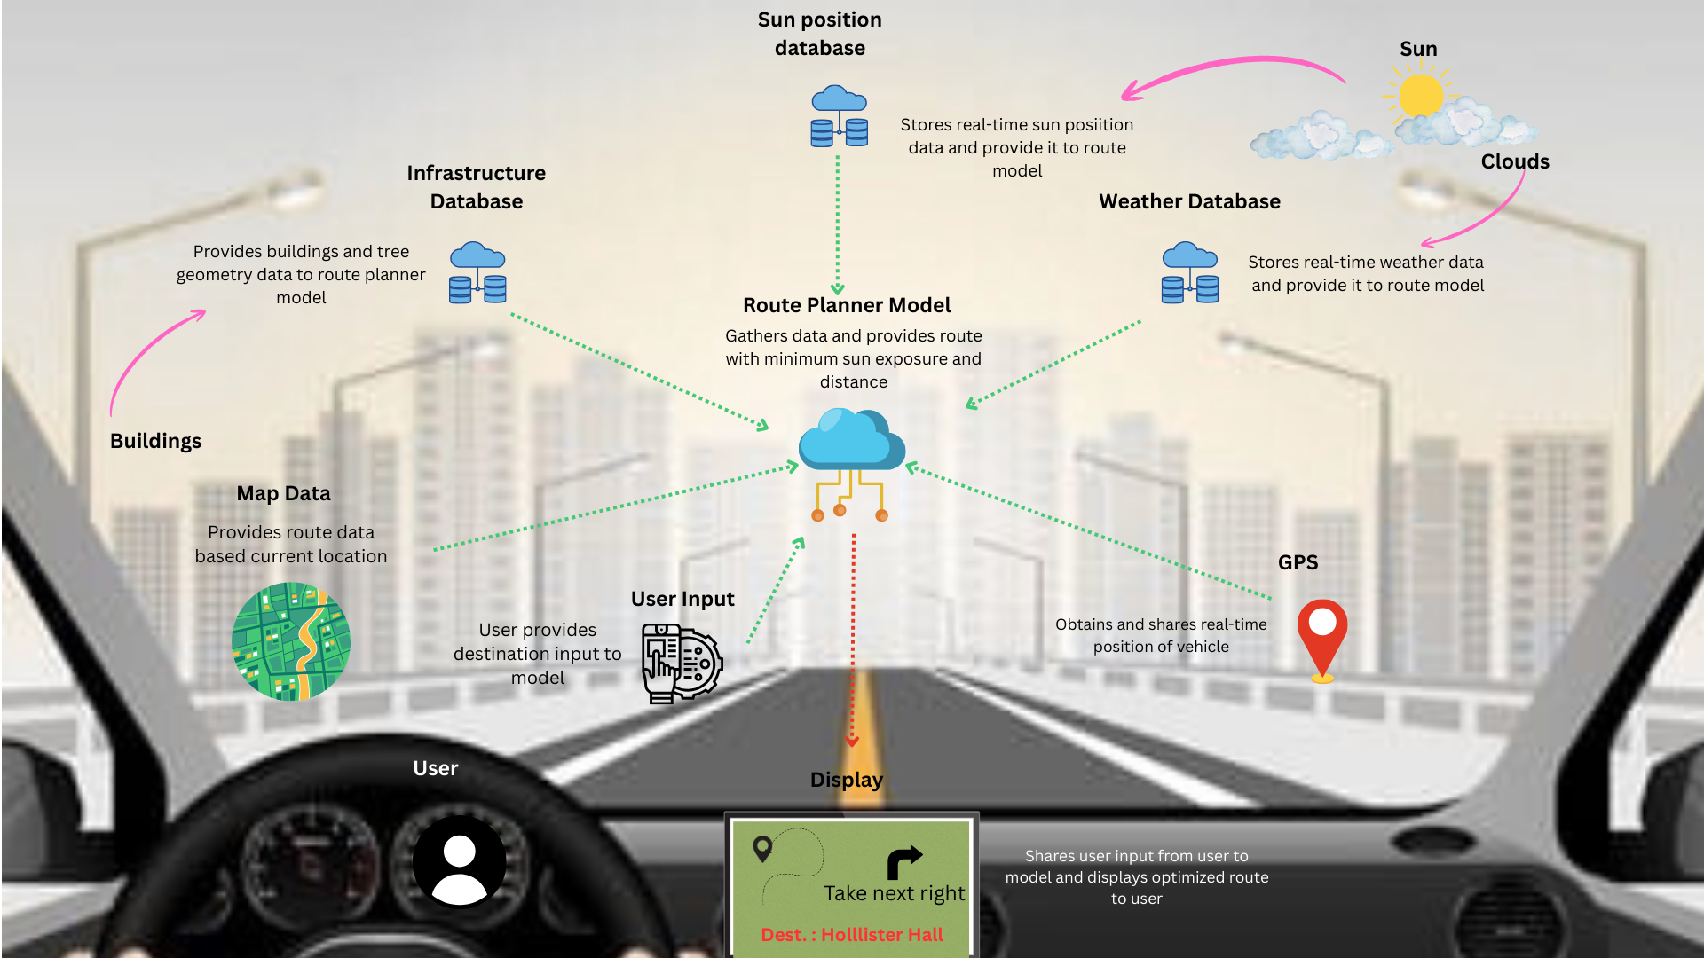
ORIGINAL

Slide 7
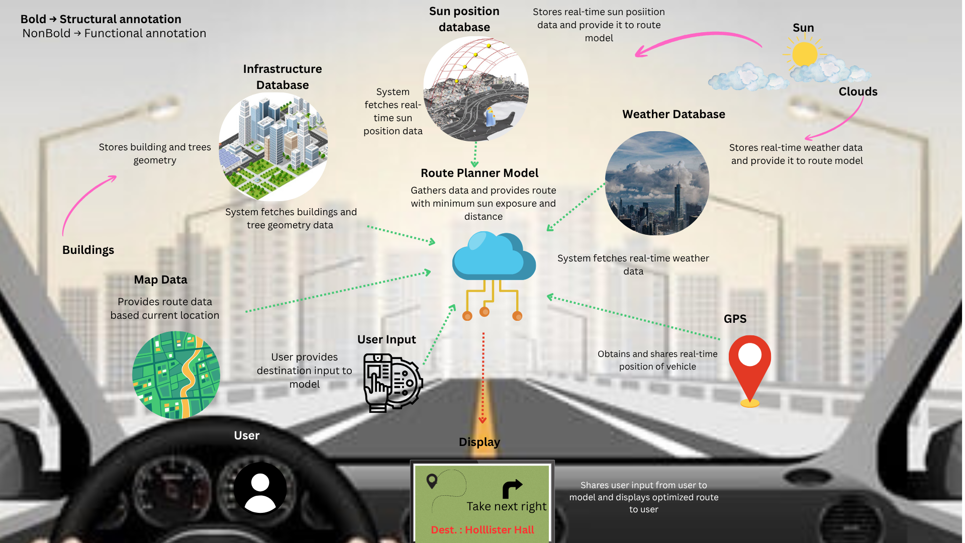

Slide 8
Context Diagram

Slide 9
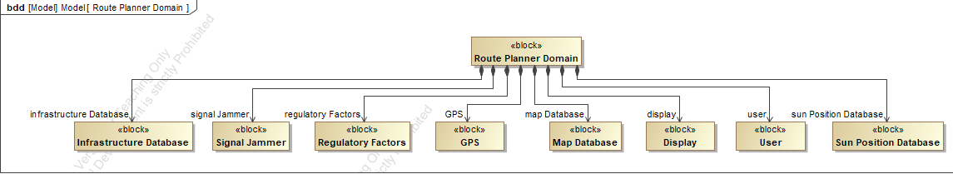
BDD diagram

Slide 10
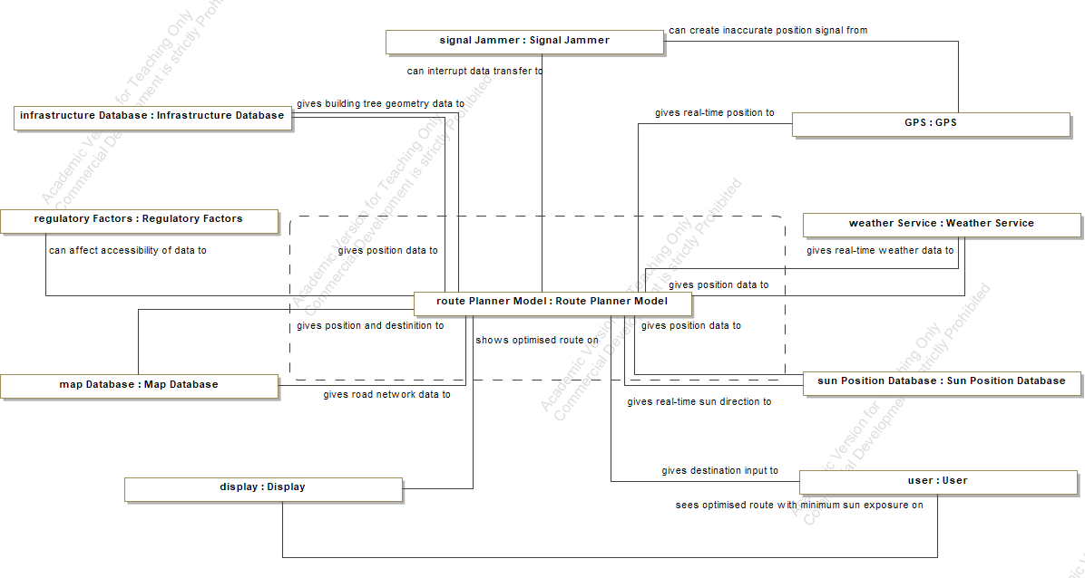
Context Diagram : IBD
*Note : part name is not removed to avoid deletion of connection in bdd diagram

Slide 11
User Story

Slide 12
User story 1
Card
The system shall provide a planned route in the absence of real-time data, ensuring uninterrupted travel and reducing sun-related health risks. The provided route shall achieve at least 98% accuracy compared to a route planned using real-time data.Offline data for route planning should be stored automatically.
Conversation
Available data storage capacity in model for offline data is 2TB.
They would like frequency of updation for infrastructure and route data to be once in a month.
They would like to store weather and sunposition forcast data of 7 days.
Maintaining accuracy with respect to relatime-data model is top priority, storage space for data is secondary priority
Confirmation
Automatic oflline data updating system is designed which can store 7 days of sun position and weather forcast data. System updates infrasturcture and route data once a month.
Model can successfuly plan the route with more than 98% of accuracy with respect to the real-time data model.

Slide 13
User Story 2
Card
The driver should be able to add intermediate stops in the route planner. The additional stops should maintain sun exposure under 50%. Addition of stops shouldnt increase planning time more than 20 seconds.
Conversation
Driver will not be able to add more than 5 stops.
They would like if stops can be added during the journey as well.
Maintaining minimum sun exposure is top priority, number of stops allowed is second priority. Third is planning timing.
Confirmation
Feature to add maximum stops before and during journey is implemented.
Model can maintain less than 50% of sun exposure with addition of 5 stops in the journey.
Planning time for 5 stops along with the destination is less than 20s.

Slide 14
SysML :Use Case Diagram

Slide 15
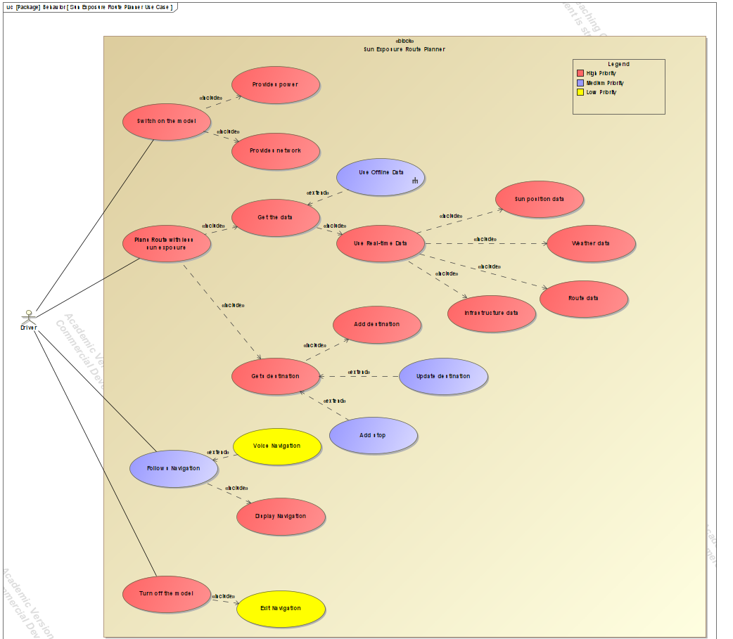

Slide 16
SysML :UCBD(Activity + Req. table)

Slide 17
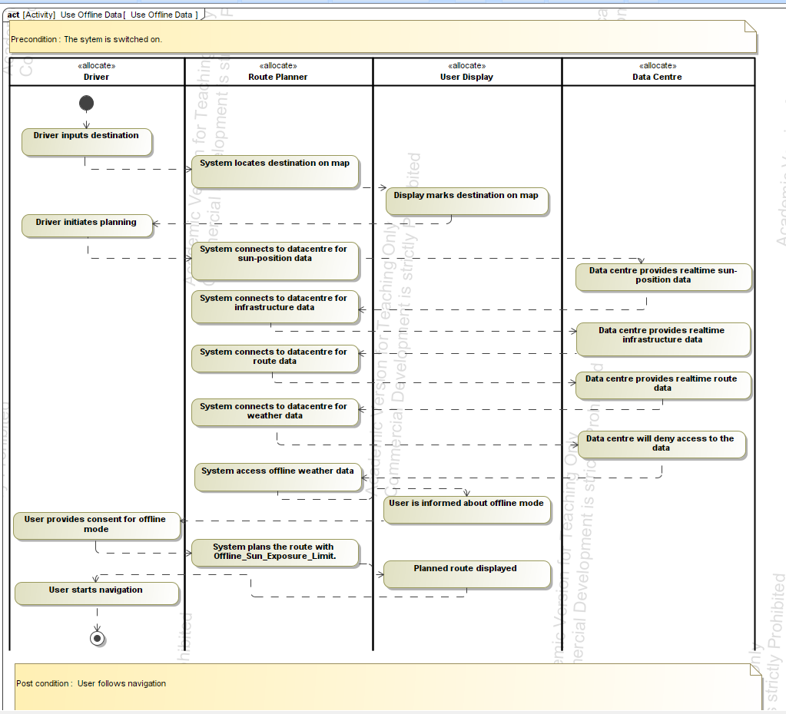
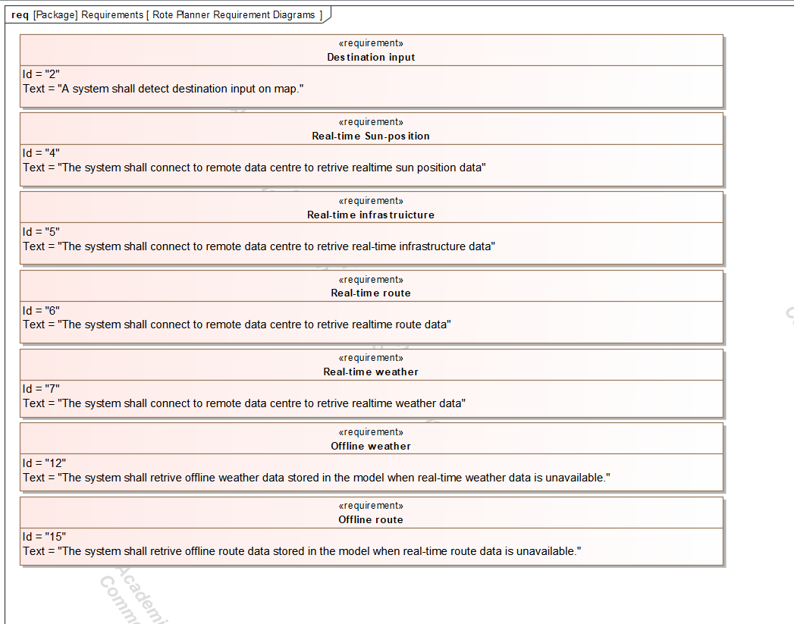

Slide 18
SysML :Requirement Diagram

Slide 20
EFFBD

Slide 21
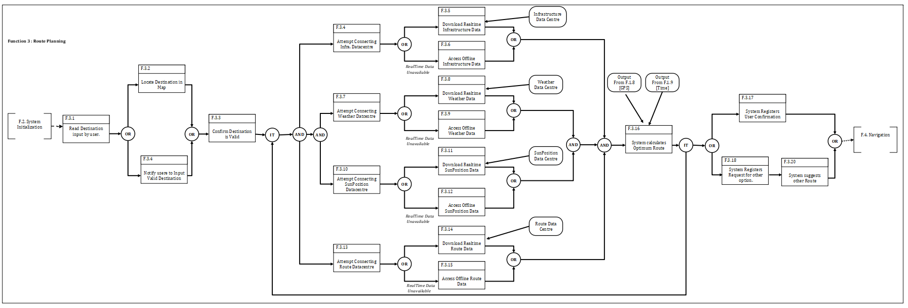

Slide 22
IDEF0

Slide 23
RealTime Infrastructure Data
RealTime Weather Data
RealTime Route Data
Realtime SunPosition Data
Destination
GPS Location
Route Planner
Final Route
Time
Base Map
Max Sun Exposure
A0
Navigation Instruction
Stops
Offline SunPosition Data
Offline Route Data
Offline Weather Data
Offline Infrastructure Data
Level 1

Slide 24
RealTime Infrastructure Data
RealTime Weather Data
RealTime Route Data
Realtime SunPosition Data
GPS Location
Initialize Model
Time
Base Map
Max Sun Exposure
A1
Loaded Base Map with Current Location
Plan Route
Final Route
Destination
A2
Stops
Navigation
Navigation Instruction
A3
Offline SunPosition Data
Offline Route Data
Offline Weather Data
Offline Infrastructure Data
Level 2

Slide 25
Loaded Base Map with Current Location
RealTime Infrastructure Data
RealTime Weather Data
RealTime Route Data
Realtime SunPosition Data
Get Destination Input
Stops
Destination
A2.1
Fetch Computation Data
Destination Located on Base Map
Preprocessed Dataset
A2.2
Predict Optimum Route
A2.3
Offline SunPosition Data
Offline Route Data
Offline Weather Data
Offline Infrastructure Data
Confirm Route
Final Route
A2.4
Optimised and Alternate routes
Level 3

Slide 26
State Diagram

Slide 27
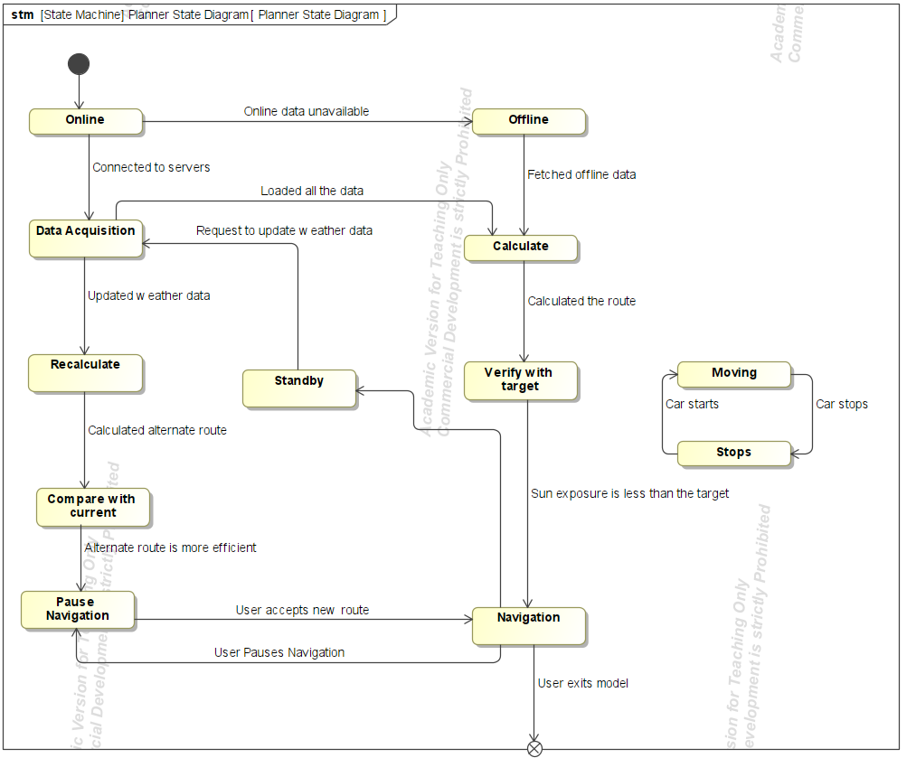

Slide 28
Sequence Diagram
Use Case : System uses offline weather data

Slide 29
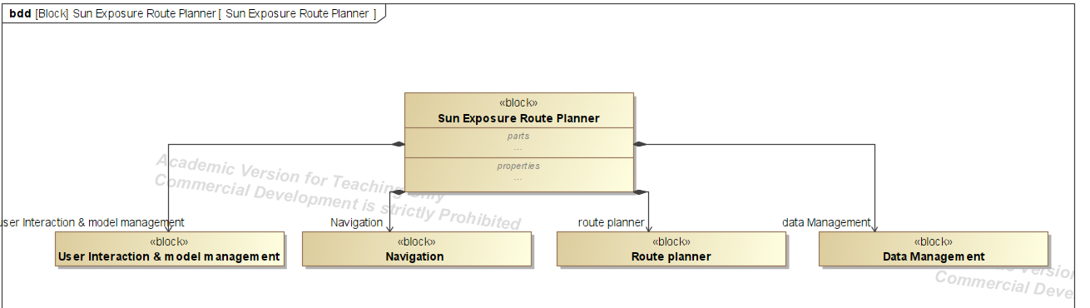

Slide 30
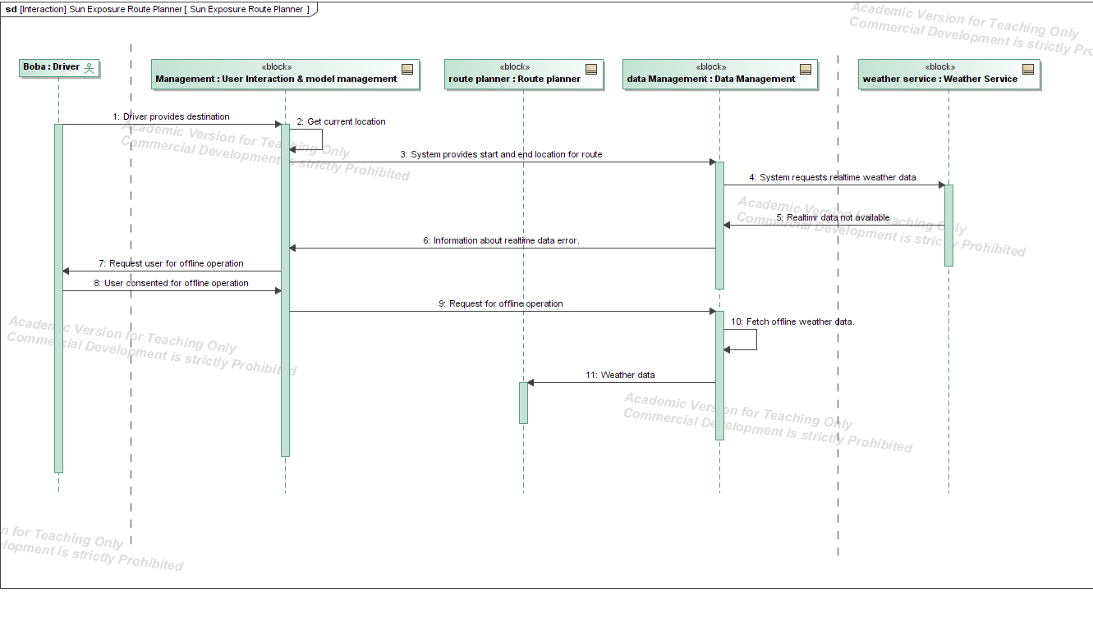

Slide 31
Parametric Diagram

Slide 32
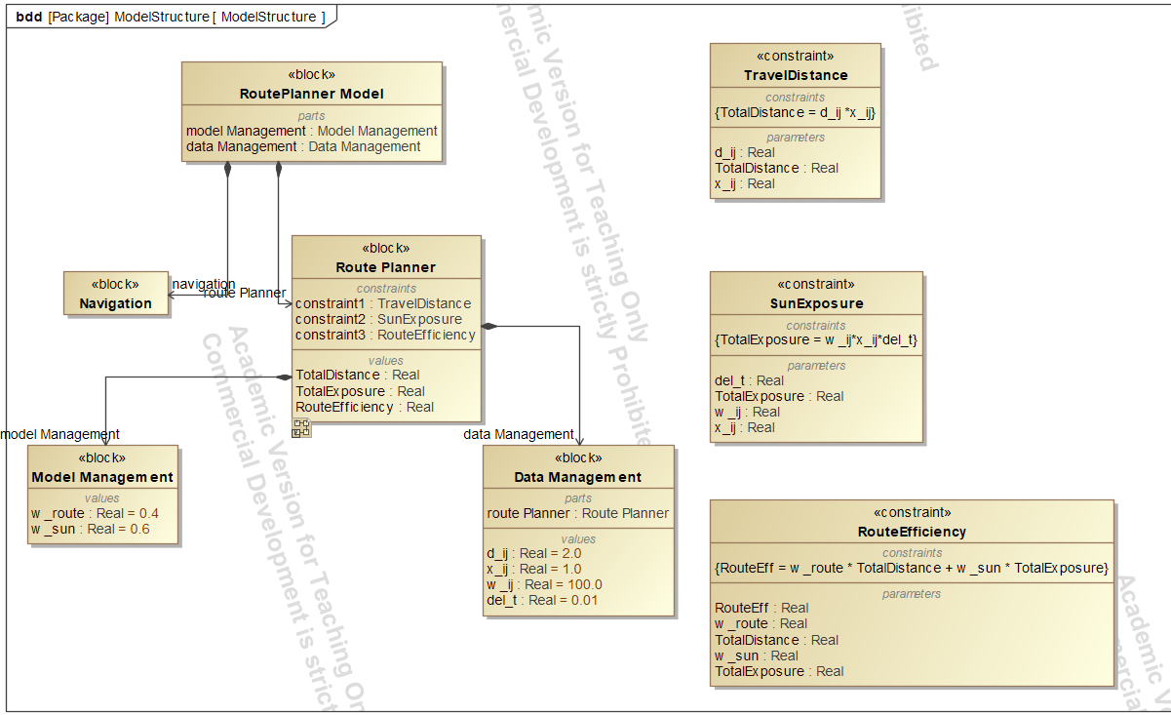
Abbreviations:
d_ij : Distance of road segment
x_ij : Selection of road
w_ij : Solar exposure intensity
del_t : Duration for exposure
TotalExposure : Total exposure during travel
TotalDistance : Total distance travelled by car
Route Eff : Efficiency of route

Slide 33
